Slide 1
OTP Register Map User Manual

Slide 2
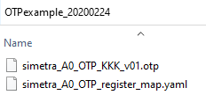
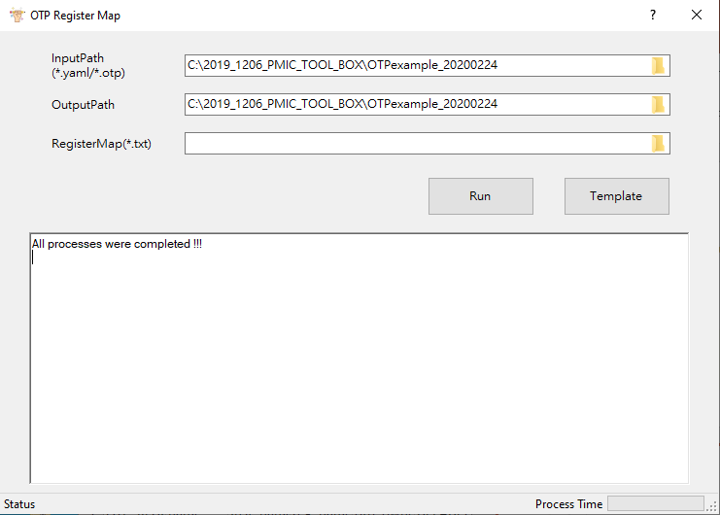
OTP Register Map : Do Not Use RegisterMap(*.txt) – 1/2
*.OPT : file with OPT data
*.yaml: file for construct frame of OTP register map
If there are multiple .otp files in the folder, it will update all in the output file
GUI of OTP register map
Do Not Use RegisterMap(*.txt)

Slide 3
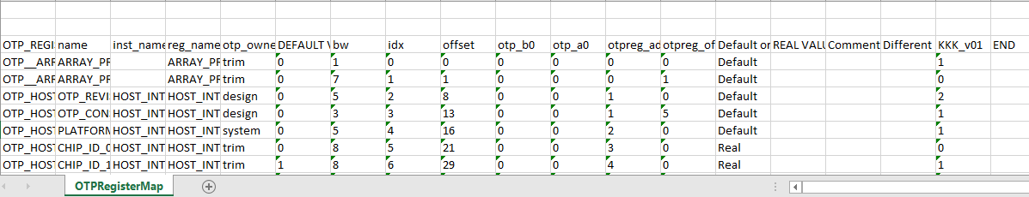
OTP Register Map : Do Not Use RegisterMap(*.txt) – 2/2
*.OPT : file with OPT data
*.yaml: file for construct frame of OTP register map

Slide 4
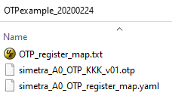
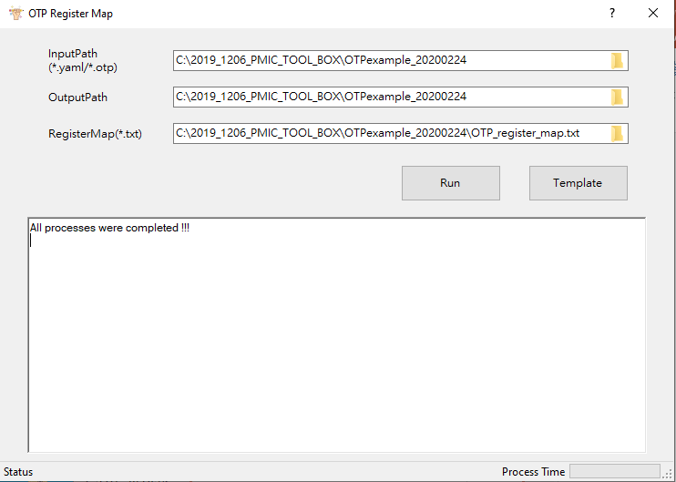
OTP Register Map : Use RegisterMap(*.txt) – 1/2
*.OPT : file with OPT data
*.yaml: file for construct frame of OTP register map
GUI of OTP register map
Use RegisterMap(*.txt)

Slide 5
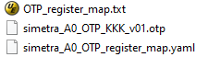
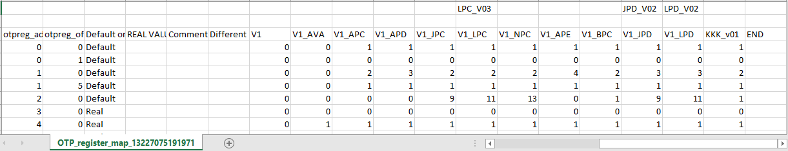
OTP Register Map : Use RegisterMap(*.txt) – 2/2
Result of Use RegisterMap(*.txt)
Result of Do Not Use RegisterMap(*.txt)

